Slide 1
Cookbook for Practice 4.3
实践4.3攻略
Cong Li 李聪

Slide 2
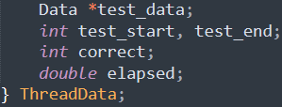
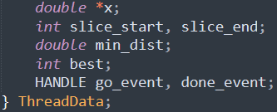
Thread Data 线程数据
Duplicate ‘dp.cpp’ as ‘dac.cpp’ 将’dp.cpp’复制为’dac.cpp’
Modify the thread data struct from 将线程数据结构
Sample to be classified,
Start & end of the training data to be processed by the thread, nearest neighbor information, 2 events for control execution
待分类数据，该线程处理的训练数据的开始和结束，最近邻信息，两个控制执行的信号
to
改为

Slide 3


Thread Function 线程函数 (1)
Now the thread function processes 1 sample
at a time w.r.t. part of the training data
现在的线程函数一次只处理一个数据，并只针对部分训练数据
Modify the loop from 将循环
to
改为
Wait for the event from main program to proceed
等待主程序的控制信号才能开始

Slide 4


Thread Function 线程函数 (2)
In the loop, modify the trackers from
在循环中，将最近邻记录
to
改为
Modify the inner loop from
将内重循环
to
改为

Slide 5
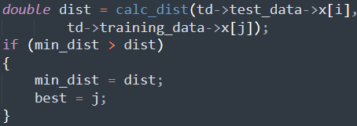
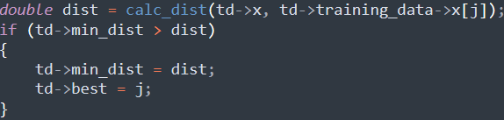
Thread Function 线程函数 (3)
In the loop, modify the distance calculation & tracking from
在循环中，将距离计算和记录
to
改为

Slide 6

Thread Function 线程函数 (4)
Replace the classification correctness check w/
将分类正确性检查
w/ a signal of completion to the main program
替换为通知主程序的完成信号
Delete the timing as the end of the thread function
把线程函数结束处的计时删除

Slide 7

Thread Data Initialization
线程数据初始化 (1)
In ‘main’ function, create the handle array for signaling thread processing completion
在’main’函数中，创建线程处理结束信号句柄的数组
Here each thread processes part of the training data but not test data. Modify
这里每个线程处理部分训练数据而非测试数据，所以将
to
改为

Slide 8


Thread Data Initialization
线程数据初始化 (2)
In the loop for thread data initialization, modify
在初始化线程数据的循环中，将
to
改为

Slide 9

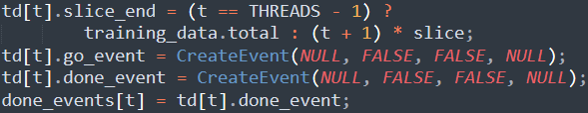
Thread Data Initialization
线程数据初始化 (3)
Delete the test data assignment in thread data
在线程数据中删除测试数据赋值
Create the events for signaling cross the main program & the worker threads, assemble the array
创建主程序和工作线程间通信的信号，并组建数组

Slide 10
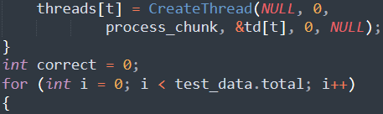
Control the Workers
控制工作线程 (1)
After starting the threads, loop over all the test data
启动各线程之后，循环遍历所有测试数据

Slide 11
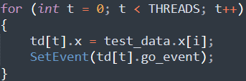
Control the Workers
控制工作线程 (2)
Set the current sample to be classified for all the threads, & then signal them to process
为每个线程配置当前要分类的数据，并通知他们开始处理
Wait for the completion from all the threads
等待所有线程处理完毕

Slide 12
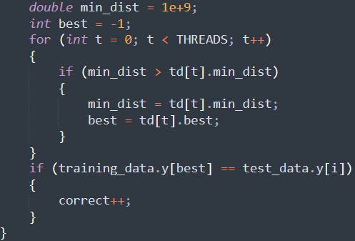
Aggregate the Results 汇总结果
Aggregate the nearest neighbors from multiple threads, get the final classification result, & check correctness
汇总各个线程的最近邻以获得最终分类结果，并检查分类正确性

Slide 13
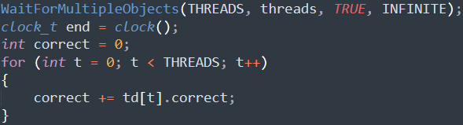
Cleanup 扫除
Delete the original aggregation in data parallelism
删除数据并行中的汇总

Slide 14
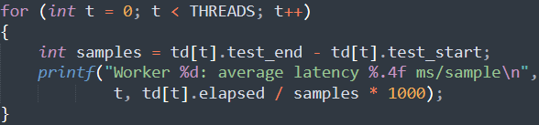

Result Output 结果输出
Modify the per-thread latency output
将每个线程的单数据耗时
to global latency
改为全局单数据耗时
Compile & run it 编译并运行之
mingw32-make SRC=dac.cpp EXTRA_CXXFLAGS="-DTHREADS=2" -B
run-dac.exe

Slide 15
The End

